Slide 1
Class Project : DDOS Attack Detection Using Machine Learning (DADML)

Slide 2
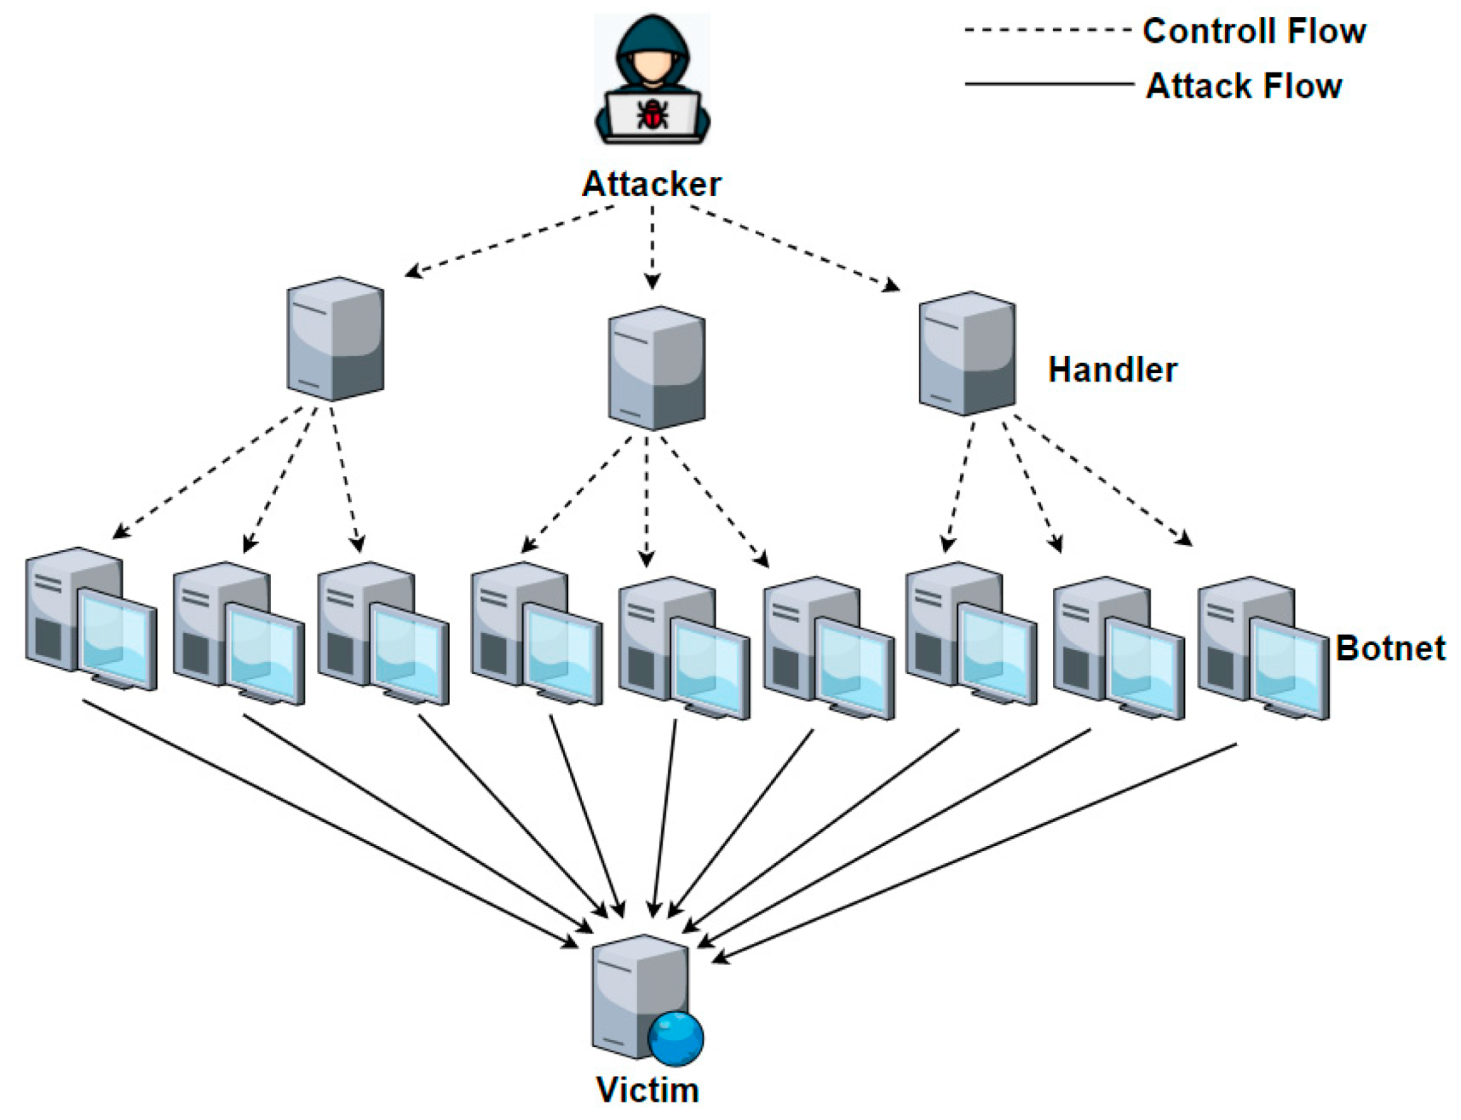
Introduction
Distributed Denial Of Service
Interrupts business flow
Damages reputation
Loss of data
Notes:
In a landscape where malicious actors continually seek fresh avenues to exploit individuals and businesses,detection of cyber attacks is key. One such attack that can cause major damage is called a distributed denial of service attack, or DDOS. There have been several research papers looking into how to detect these attacks more efficiently. And while they go about it in different fashions, the ones we chose used machine learning.

Slide 3
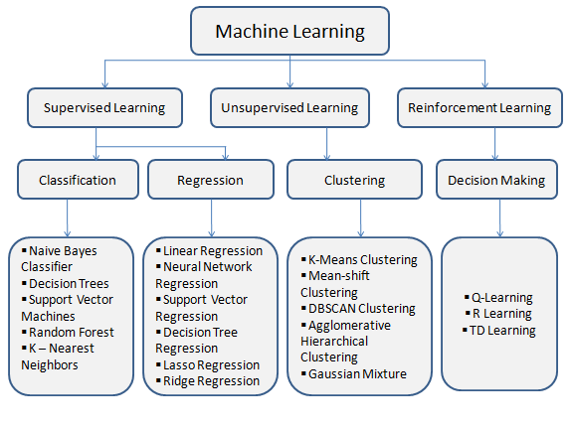
Machine Learning
Machine Learning
Adaptable
Accurate
Efficient
Notes:
Machine learning is branch of artificial intelligence which aims on using data to train a model that gradually increases in accuracy the more data is fed to it.. Some employ the use of SNORT which is an open source intrusion detection system and other use algorithms like random forest and linear regression. Some projects opt for a hybrid approach, combining these methods for reduced false positives and heightened accuracy. The goal of our project was to train a machine learning program to successfully and accurately detect DDOS attacks. To do this we employed the use of logistic regression and support vector machines.

Slide 4
DDoS Attack Simulation
Step 1 – Attacker system (running Kali Linux) and Target system (running Windows 10) set up in Oracle VirtualBox.
Step 2 – Both systems placed in the same subnet – 192.168.100.0/24 (IP address of attacker system – 192.168.100.4, IP address of target system – 192.168.100.5).
Step 3 – Connectivity verified using the Ping command.
Step 4 – List of open ports on the target system obtained using Nmap (Command used – nmap 192.168.100.5).
Step 5 – DDoS attack against port 135 of the target system initiated using Hping3 (Command used – hping3 -S --flood --rand-source 192.168.100.5 -p 135).

Slide 5
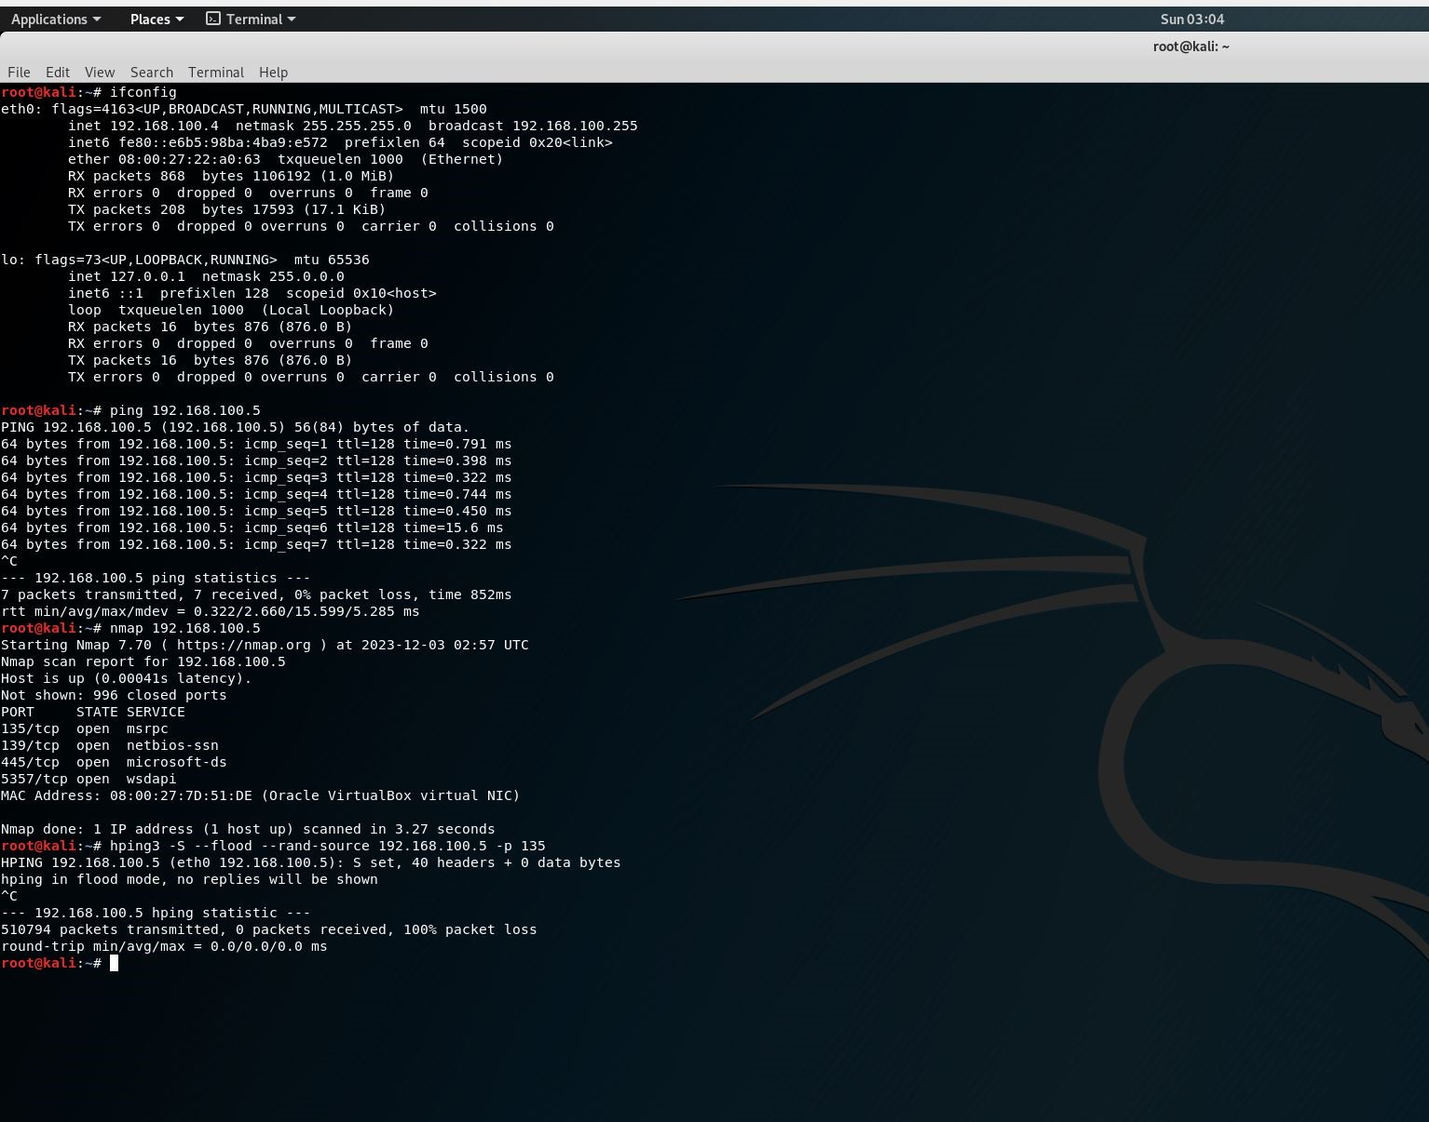
DDoS Attack Simulation

Slide 6
Packet Capture
Step 1 - Details of all packets associated with 192.168.100.5 captured using Wireshark.
Step 2 – Capture saved as a PCAP file.
Step 3 – Features extracted and subsequently exported to a CSV file using CICFlowMeter.

Slide 7
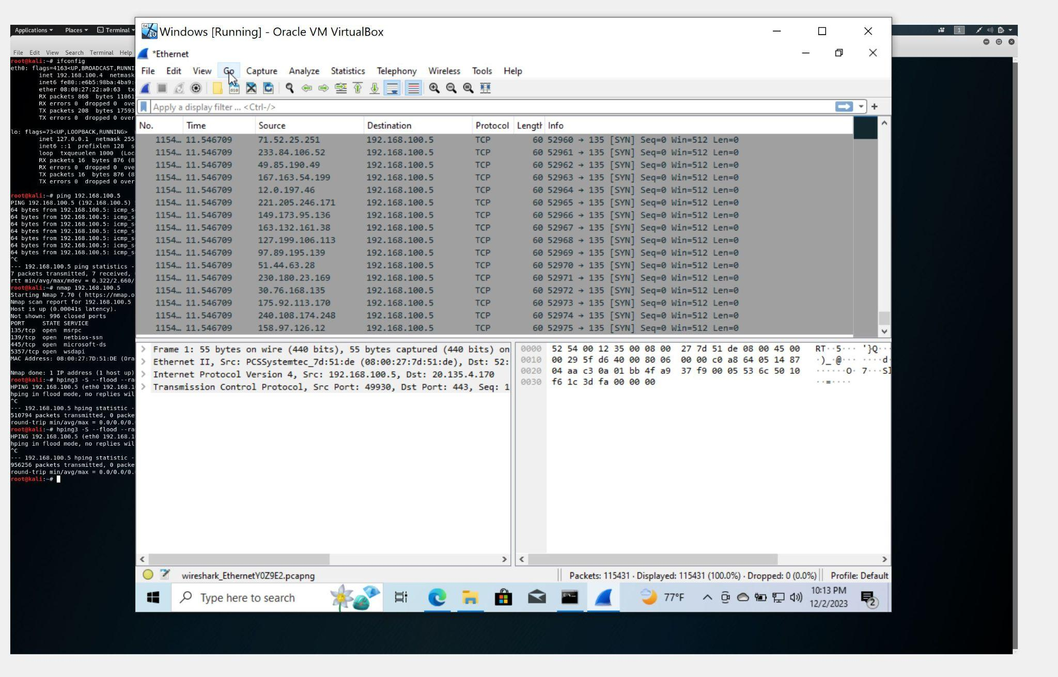
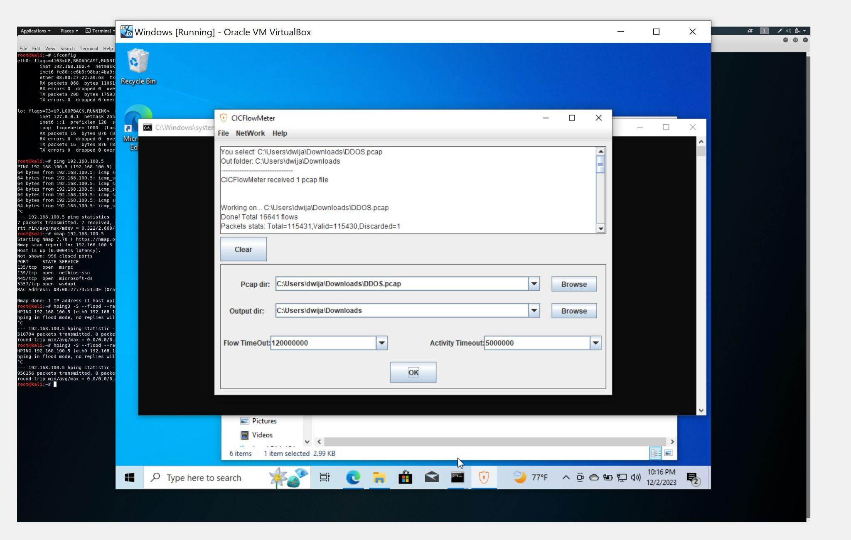
Packet Capture

Slide 8
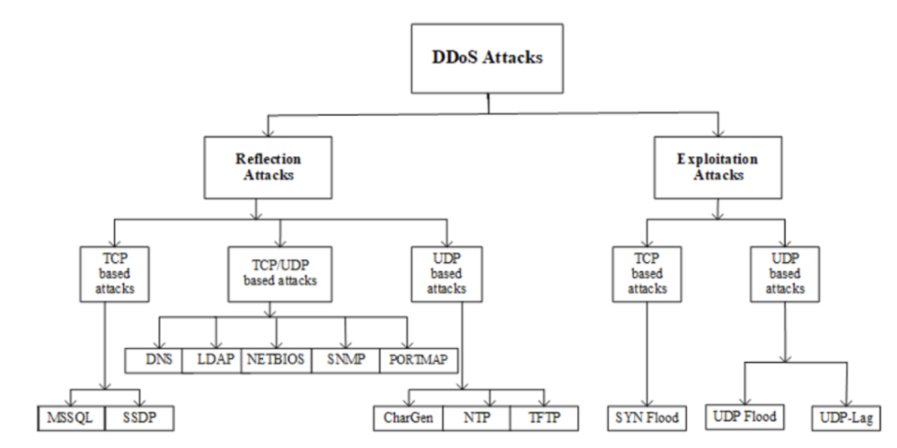
Datasets CIC-DDoS2019
Developed by the Canadian Institute for Cybersecurity
Wide range of benign and common DDoS attacks, simulating realistic real-world data

Slide 9
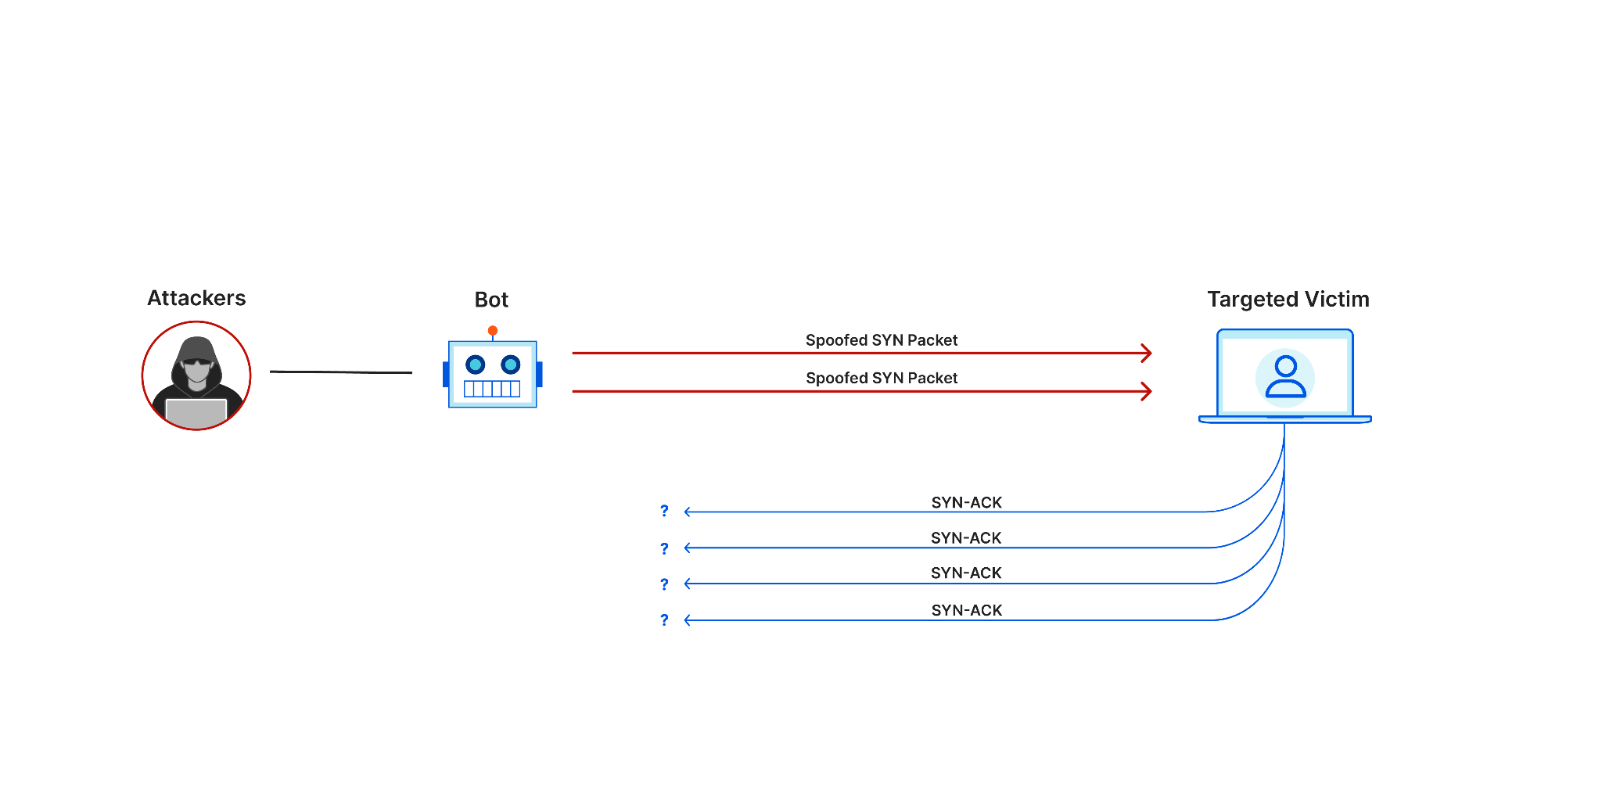
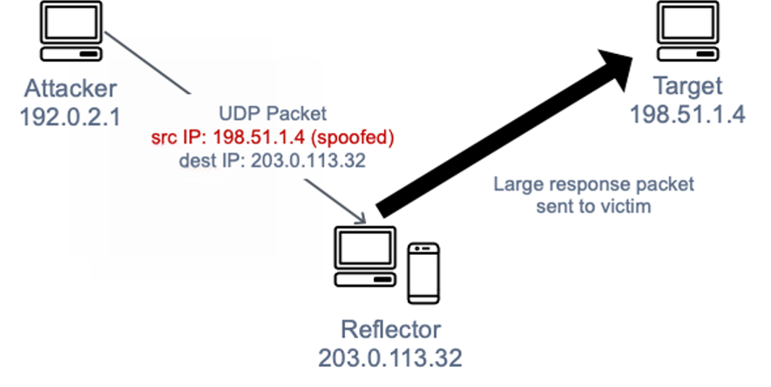
Datasets CIC-DDoS2019
Reflection-based attack
Exploitation-based attacks

Slide 10
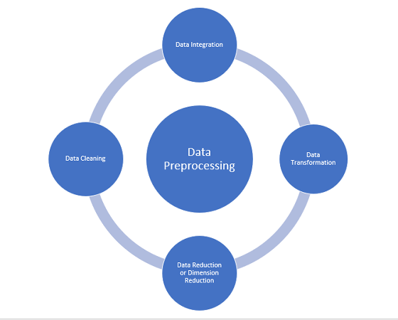
Preprocessing
Checking for Null Values
Checking for Duplicate Values
Checking Data Imbalance (Protocol)
Balancing Data using Random Over Sampling
Balancing Data using SMOTE
Reordering Data
Label encoding
Min-Max Scaling
Correlation-based Feature Removal
Feature Selection using Extra Trees Classifier

Slide 11
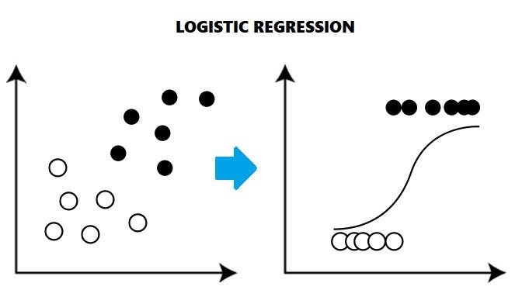
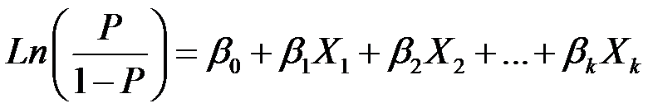

Logistic Regression
binary classification
Logistic function
cost function that penalizes the model for misclassifying instances
simplicity, interpretability, and effectiveness

Slide 12
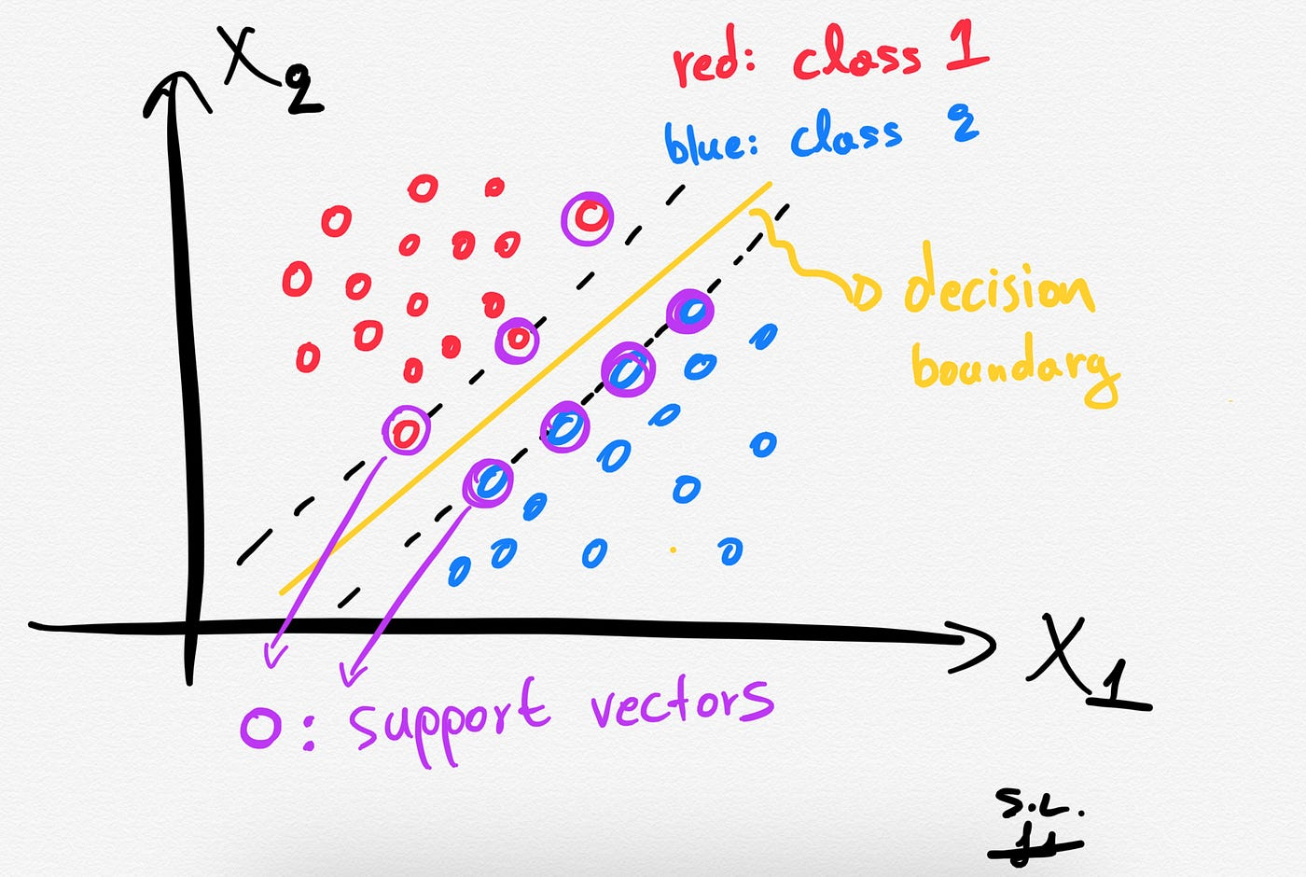
Support Vector Machines (SVM)
Supervised machine learning algorithm
Classification and regression tasks
Finding a hyperplane in a high-dimensional space
Handle nonlinear decision boundaries
Finding the optimal hyperplane that maximizes the margin between classes
SVM can handle non-linear decision boundaries through kernel functions like polynomial or radial basis function (RBF)
The algorithm minimizes classification errors while considering a soft margin in real-world scenarios, controlled by the regularization parameter (C)

Slide 13
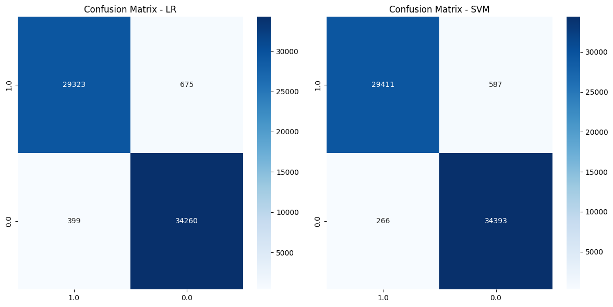
Result on CICDDOS-2019

Slide 14
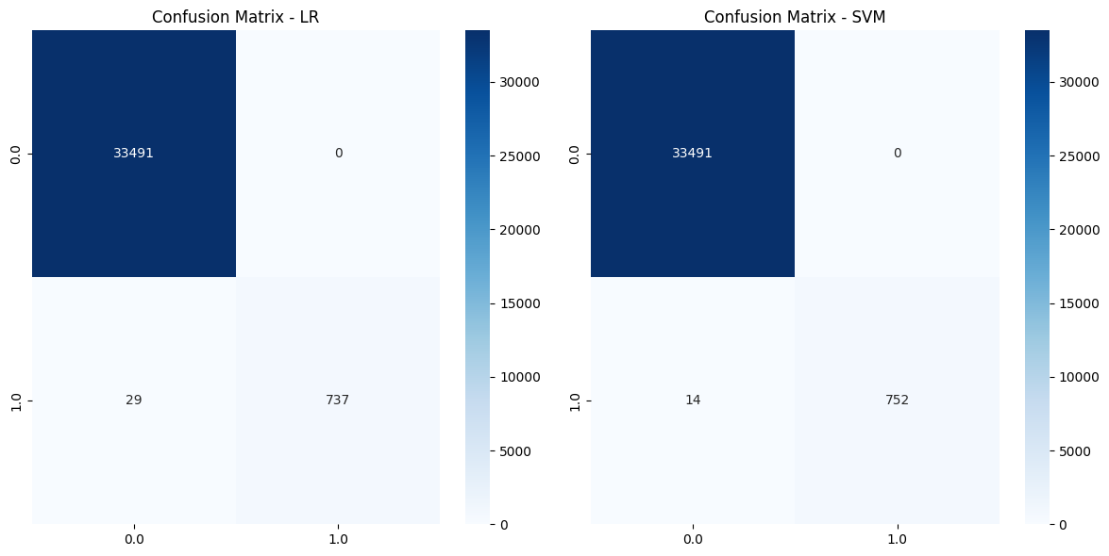
Result on Simulated Dataset

Slide 15
Conclusion and Future Works
High accuracy on detecting DDOS on CICDDOS-2019 dataset
Simulation real time traffic
Simulating DDOS attack
High accuracy on detecting simulated DDOS attack
Implement the method on real time network simulation (Mininet)
Simulate the DDOS attack on Mininet

